Slide 1
Hotel Project Analysis Presentation

Slide 2
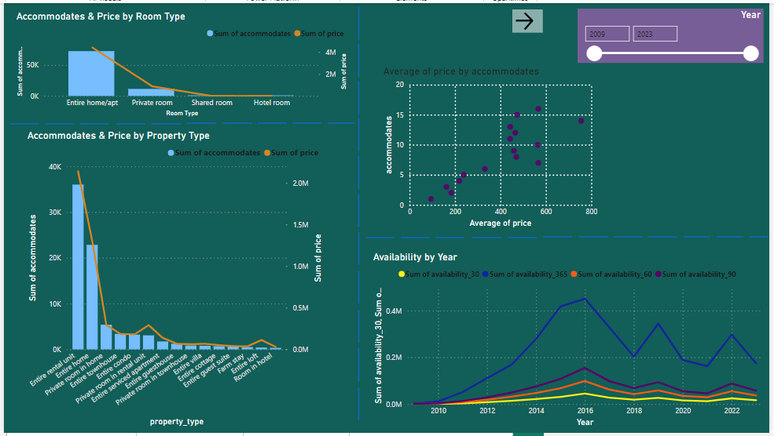
Project analysis slide 5
Hotel Project Analysis
1- Pricing and Availability

Slide 3
Project analysis slide 5
Hotel Project Analysis
I choosed this chart because actually we can determine the best property type by the price & accomondates clearly.
The Entire is undisputedly the best and the private comes after it. - so we have to take care more about the other property ..

Slide 4
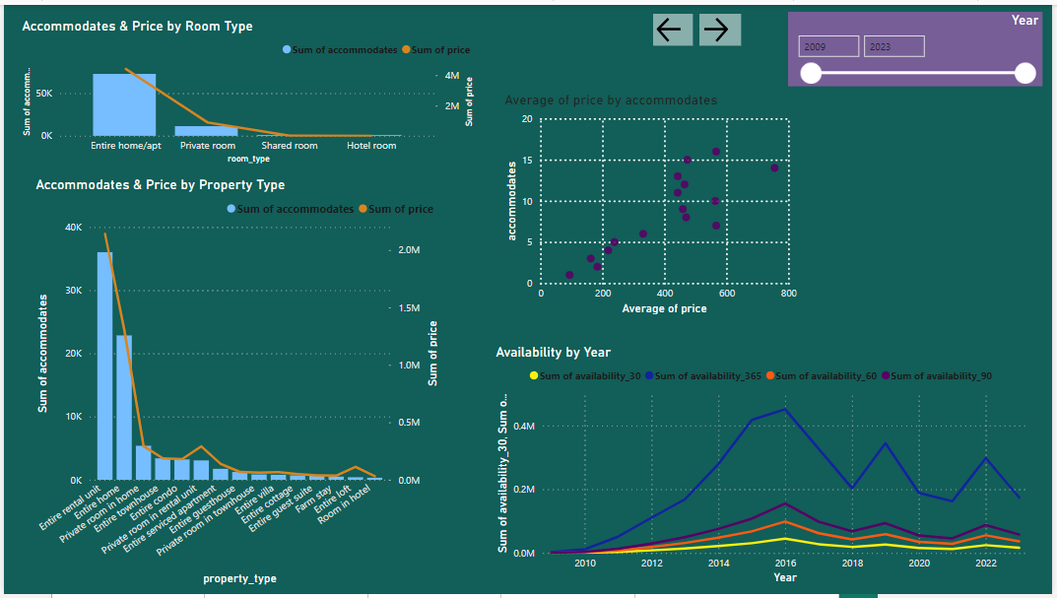
Project analysis slide 5
Hotel Project Analysis
Here we can see the Correlation between Accommodates and the Price. It’s a strong positive relation.
The peak period of the all types of Availability is 2014 & 2015 (2014 – 2016).

Slide 5
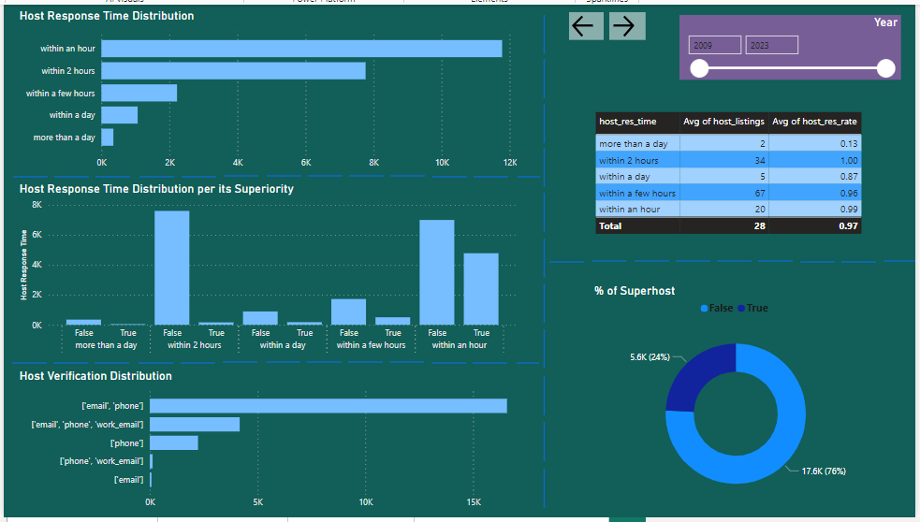
Project analysis slide 5
Hotel Project Analysis
2- Host Performance

Slide 6
Project analysis slide 5
Hotel Project Analysis
These 2 charts can show us the Distribution of Verification & Response Time of the host.
We can see in the first chart that most of hosts response time is within an hour. It meets the guests satisfaction but not the only factor. In the second chart, “email – phone” category is the most used communication way for host response. We should give more interest for “work email” way. maybe we missed some guests because of that

Slide 7
Project analysis slide 5
Hotel Project Analysis
These charts can explain that Response Time is not the only factor for guests satisfaction. As we know, the most of hosts response time is within an hour. But as it’s showen, 24% of host is sorted to superhost & it’s a little percentage compared with the best response time count. Again, we can notice that in “within an hour” Category, False count ( not superhost ) is larger than True count ( actually superhost ) and in the top 2 most frequent category “within 2 hours” ( too clear in the previous slide ), False count is too large compared to True count. So, response Time is not the only factor for guests satisfaction . - We should spotlight and discover the other attributes of hosts .

Slide 8
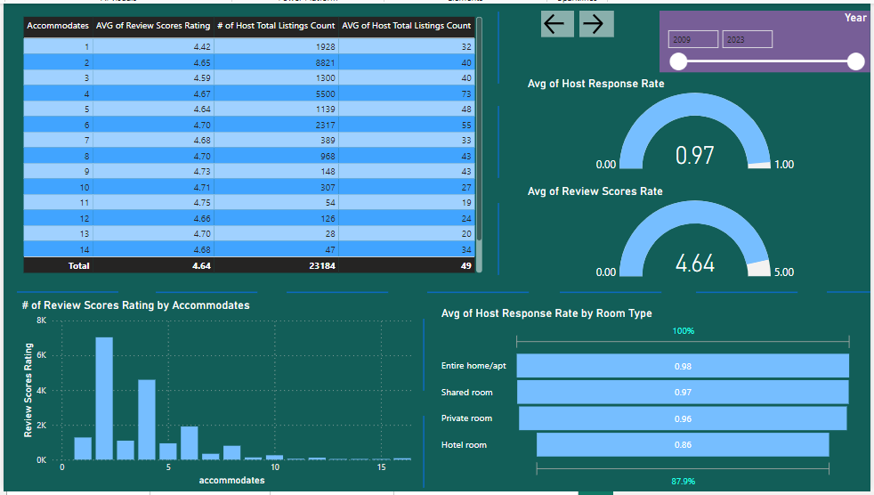
Project analysis slide 5
Hotel Project Analysis
3- Guest Satisfaciton

Slide 9
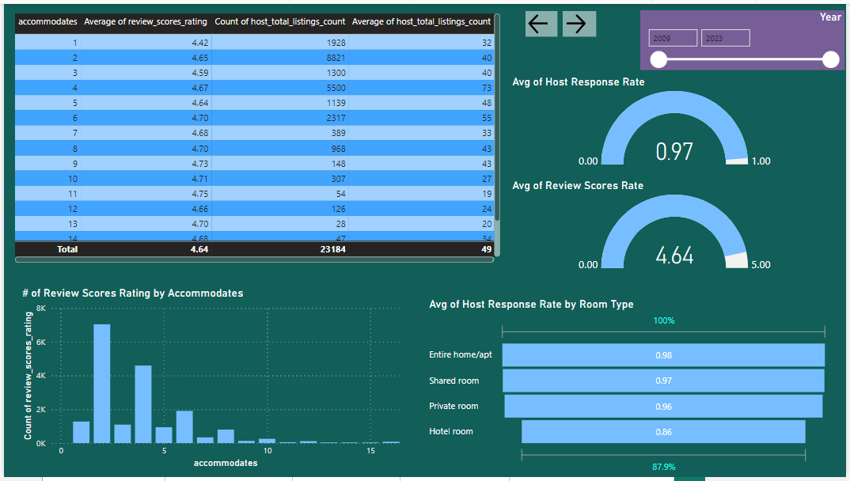
Project analysis slide 5
Hotel Project Analysis
It’s all right but unusually, i think it is not the full picture. Maybe we have to check and write down other details. It is not possible that around every rate about the hosts we all have is very heigh. - So the same as my vision, we should spotlight on the other attributes of hosts to find out more about our service performance ( like number of complaints, attendance & absence time, behavioral observation, how many days does its customer for each host stay and making it a score … etc )

Slide 10
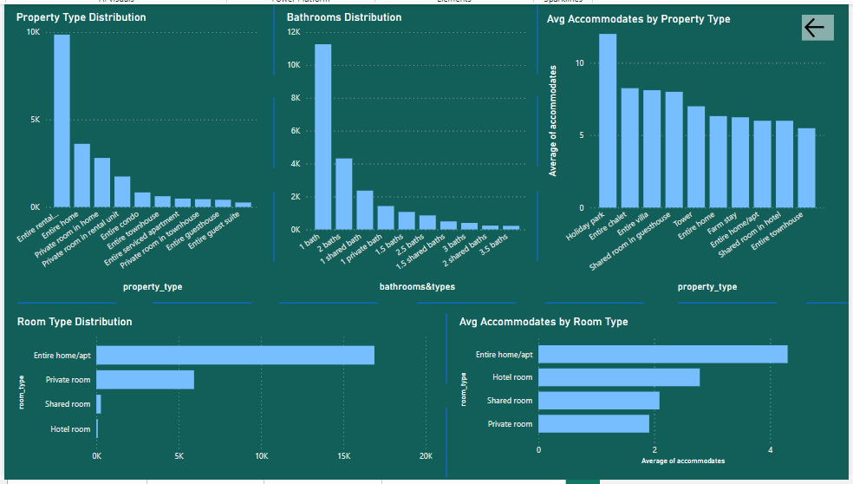
Project analysis slide 5
Hotel Project Analysis
4- Property & Room Type Analysis

Slide 11
Project analysis slide 5
Hotel Project Analysis
These 2 charts can show us the Distribution of property Type & Bathrooms.
- Entire & Private type is the best with no doubt. - Apartments with a little number of bathrooms ( 1 - 3 ) ,with no regardless about its type ( shared , private normal ), is the most wanted. - We have to take care about the other types of Property and apartments with more than 3 Bathrooms. - Search more and survey the guests about the why of their preferences. - Mix between the most wanted property type with the big numbers of bathrooms & vice verse to make it more preferred.

Slide 12
Thank You

